Slide 1

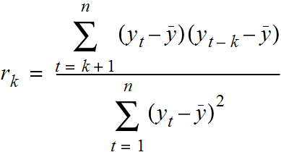



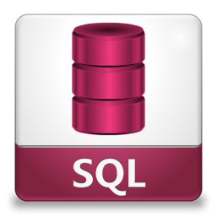









WHAT & WHY?
BASIC SETUP

Slide 2

BASIC DEFINITIONS
Business knowledge can include understanding: Knowing KPI’s, Gather requirements, MetaData, Operational reports, Business acumen, communication and navigating politics and personalities of your business culture
Having a strong understanding of Lookup functions, string and numeric functions is necessary to understand the business and how the currently tackle problems.
Basic Statistics(Central Tendency) Understanding concepts is fine. Understanding long hand even better.
This is a must to understand the basic charts and graphs and be able to tell a story with them.
Structured Query Language: Unless someone is getting all of your data for you and cleaning it all for you, you will want to be proficient in SQL up to Advanced levels.

Slide 3
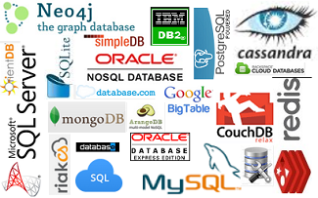
BASIC DEFINITIONS
Data storage, Understanding schemas, tables, fields, relational and non relational databases is a foundation of data analytics

Slide 4

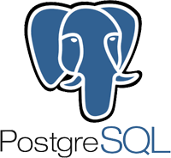
BASIC DEFINITIONS
Oracle express 11g edition/ Oracle SQL Developer
Postgres/Pgadmin4

Slide 5

BASIC CONCEPTS
Python is a general purpose programing language. Allows you to give directions to a computer to tell it what to do.
R is a system for statistical computation and graphics.
SAS SAS (Statistical Analysis System) is a software suite developed by SAS Institute for advanced analytics, multivariate analyses, business intelligence, data management, and predictive analytics.
SPSS Modeler IBM SPSS Modeler is a data mining and text analytics software application from IBM. It is used to build predictive models and conduct other analytic tasks

Slide 6



BASIC CONCEPTS
Jupyter Notebooks allows you to create and share documents that contain live code, equations, visualizations and explanatory text.
Plain text formatter that converts for use in html, used to create documentation within Jupyter
Purpose of git is to manage a project, or a set of files as they change over time. It allows for version control and collaboration.
Command line is a user interface to a computers operating system. It allows you to navigate, manipulate and analyze files, data and more.

Slide 7



Python Vs R
Notes:
There are a lot of pros and cons to both R and Python in the end if you are going to put something in Production use Python, if you are just exploring use R.
Advice learn python first when you feel good with python learn R.

Slide 8
Training Path
Statistics
Python
Excel
SQL
Tableau
CMD line
Git
Jupyter
SPSS Modeler
Python
R

Slide 9
Training Path
Data Analytics workflow
Identify a problem
Obtain Data
Understand Data
Prepare Data
Analyze Data
Present Data

Slide 10
Training Path
Data Science Workflow
Define feature vector matrix
Choose an estimator
Insatiate the estimator
Make a prediction
Evaluate the model

Slide 11











Reality of Workflows

Slide 12



WORKFLOWS ITERATE

Slide 13
AGILE

Slide 14







SETUP
ANACONDA
GITBASH

Slide 15
DEMO
Set up Sandbox using command line
Pull data using git
Analyze data using cmd
Create program in python
Run program in cmd line
Push data to git
Document using markdown in jupyter notebooks

Slide 16
SET UP SANDBOX USING CMDLINE
pwd Present working directory
ls- list files directories and subdirectories
cd Change directory
cd path/ Change directory and path name
mkdir- make a new directory
Git init – initialize new git repository
Exercise
Make a new directory on your desktop called Sandbox
In Sandbox make another directory called Dsintro
Notes:
Basic commands Actions pwd present working directory ls lists files and subdirectories in your working directory ls -a lists all files, including hidden files ls -l lists the files in a long format with extra information (permissions, size, last modified date, etc.) ls * also lists the contents of subdirectories (one level deep) in your working directory ls<path> lists files in a specific directory (without changing your working directory) clear clears all output from your console cd moves you to your "home" directory cd<path> changes directory to the path you specify, which can be a relative path or an absolute path cd.. moves you "up" one directory (to the parent directory) mkdir<dirname> makes a new directory called <dirname> touch creates an empty file called <filename>, This is useful for creating empty files to be edited at a later time. touch <filename1> <filename2> <filename3> ... Multiple empty files rm<filename> removes file or deletes it permanently rm-i<filename> removes files in interactive mode, in which you are prompted to confirm that you really want to delete the file. It's best to always use rm -i. rmdir<dirname> rmdir <dirname> removes a directory and recursively deletes all of its contents mv<filename><new path> moves file from its current location to <new path> use this as well to rename a file cp<filename><new path> copies fa file from it's current location to <new path>, leaving the original file unchanged.

Slide 17
PULL DATA USING GIT
git fetch https://github.com/Morrisdata/Python_for_Data/
What just happened and why do you care?
head<filename>
prints the head (the first 10 lines) of the file
head -n20 <filename>
prints the first 20 lines of the file
tail <filename>
prints the tail (the last 10 lines) of the file

Slide 18
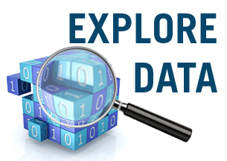
EXPLORE DATA USING PYTHON
Notes:
#Import libraries
import pandas as pd
import matplotlib.pyplot as plt
# increase default figure and font sizes for easier viewing
plt.rcParams['figure.figsize'] = (8, 6)
plt.rcParams['font.size'] = 14
# read in the drinks data
drinks = pd.read_csv('~/Desktop/DataScience/drinks.csv')
#EXPLORE DATA
drinks.dtypes # data types of each column
drinks # print the first 30 and last 30 rows
type(drinks) # DataFrame
drinks.head() # print the first 5 rows
drinks.head(10) # print the first 10 rows
drinks.tail() # print the last 5 rows
drinks.index # "the index" (aka "the labels")
drinks.columns # column names (which is "an index")
drinks.shape # number of rows and columns
drinks.values #
# ## Bar Plot: show a numerical comparison across different categories
# count the number of countries in each continent
drinks.continent.value_counts()
# compare with bar plot
drinks.continent.value_counts().plot(kind='bar')
# calculate the mean alcohol amounts for each continent
drinks.groupby('continent').mean()
# side-by-side bar plots
drinks.groupby('continent').mean().plot(kind='bar')
# drop the liters column
drinks.groupby('continent').mean().drop('total_litres_of_pure_alcohol', axis=1).plot(kind='bar')
# stacked bar plots
drinks.groupby('continent').mean().drop('total_litres_of_pure_alcohol', axis=1).plot(kind='bar', stacked=True)

Slide 19

Training Path
Notes:
http://scikit-learn.org/stable/tutorial/machine_learning_map/

Slide 20
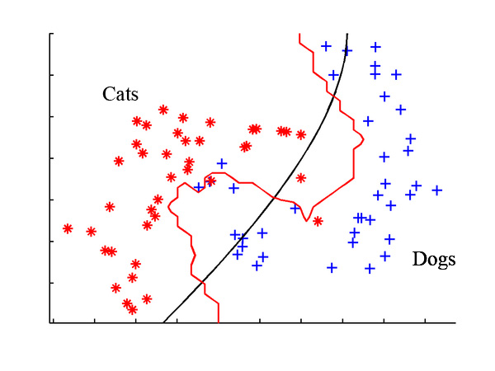
Classification
Notes:
Likelyhood something is in a category

Slide 21
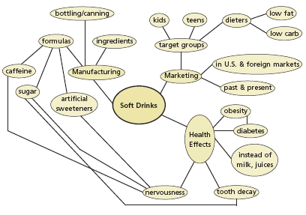
Clustering
Notes:
How one thing leads to another

Slide 22
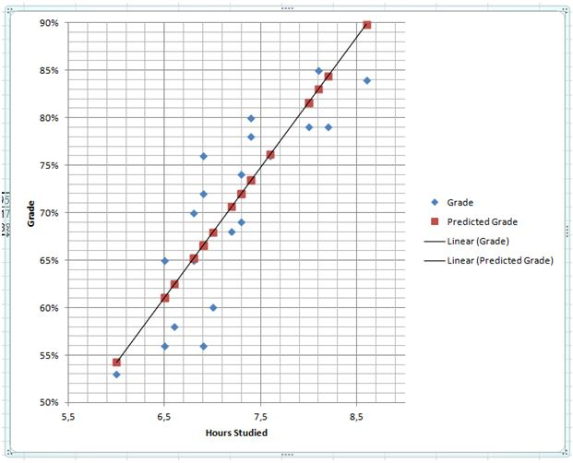
Regression
Notes:
http://scikit-learn.org/stable/tutorial/machine_learning_map/

Slide 23
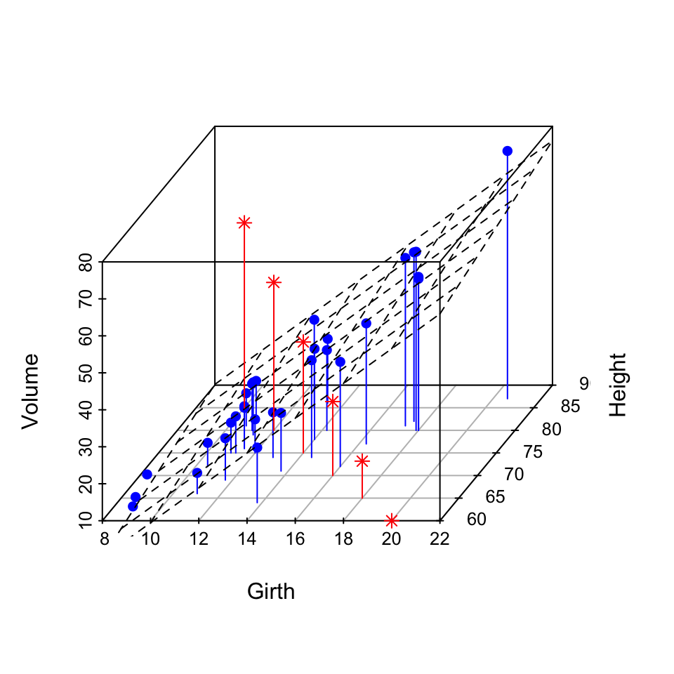
Dimensionality Reduction
Notes:
In machine learning and statistics, dimensionality reduction or dimension reduction is the process ofreducing the number of random variables under consideration, via obtaining a set of principal variables. It can be divided into feature selection and feature extraction

Slide 24
WHAT DID WE JUST DO?
Set up Sandbox using command line
Pull data using git
Review data using cmd
Explore data using Python
Basic concepts of predictive models

